Slide 1

Subject: DevOps
Module Number: 1
Module Name: Introduction to DevOps
SME NAME: V.Manikandan
AP/CSSP

Slide 2
Introduction to DevOps
        Syllabus
What Is DevOps, History of DevOps, DevOps definition, DevOps Main Objectives, DevOps and Software Development Life Cycle (Waterfall Model, & Agile Model)
Continuous Integration & Deployment (Jenkins), Containers and Virtual Development (Docker, Vagrant), Configuration Management Tools (Ansible, Puppet & Chef)

Slide 3
Introduction to DevOps
        AIM:
To establish the knowledge of Software Development and IT Operations.

Slide 4
Introduction to DevOps
        Objectives:
The Objectives of this Module is to:
The background and mindset of DevOps
To Understanding the DevOps and Software Development Life Cycle
To Know about Continuous Integration & Deployment Jenkins and Configuration Management Tools

Slide 5
Introduction to DevOps
        Outcomes:
At the end of this Module, Students will be able to:
To Understanding the Concept of DevOps its Life Cycle
To Learn the CI & Deployment Jenkins and various Configuration Management Tools

Slide 6
Introduction to DevOps
        Table of Content:
What Is DevOps
History of DevOps
DevOps definition
DevOps Main Objectives
DevOps and Software Development Life Cycle (Waterfall Model, & Agile Model)
Continuous Integration & Deployment (Jenkins)
Containers and Virtual Development (Docker, Vagrant)
Configuration Management Tools (Ansible, Puppet & Chef)

Slide 7
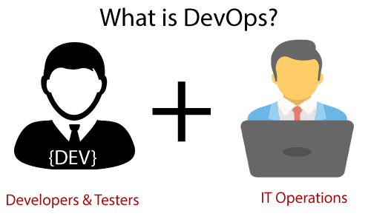
Introduction to DevOps
        What Is DevOps?
It is the union of people, process, and technology to continuously give value to consumers. It is a blend of development (Dev) and operations (Ops).

Slide 8
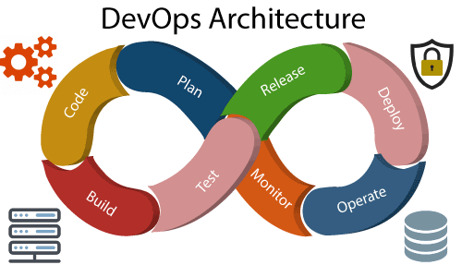
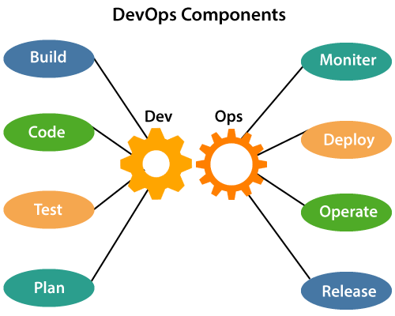
Introduction to DevOps
        DevOps Architecture & Components

Slide 9
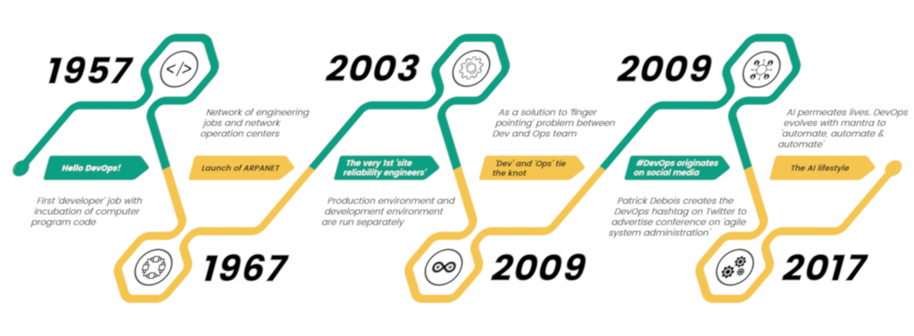
Introduction to DevOps
        History of DevOps

Slide 10
Introduction to DevOps
        DevOps Main Objectives
Automate for Build
Automat Testing
Automate Deployment
Automate Monitoring
Automate Issue Tracking
Automate Feedbacks

Slide 11
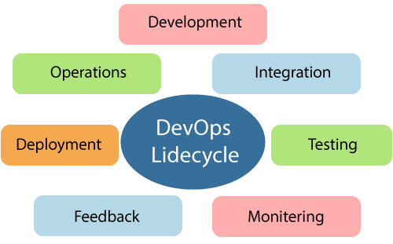
Introduction to DevOps
        DevOps Lifecycle

Slide 12
Introduction to DevOps
        Continuous Development
This phase entails the software's planning and coding.
During the planning phase, the project's vision is decided.
And the programmers get to work on the application's coding.
There are no DevOps tools required for planning, however there are a number of tools available for code maintenance.

Slide 13
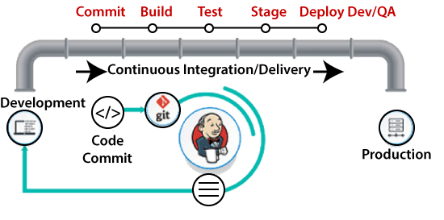
Introduction to DevOps
        Continuous Integration
This is the most important stage in the DevOps lifecycle.
It is a software development practise that requires developers to commit source code changes more frequently. This could be done once a day or once a week.
Then each commit is created, allowing for early discovery of any errors that may exist. Not only does compiling code entail unit testing, integration testing, code review, and packaging, but it also entails unit testing, integration testing, code review, and packaging.

Slide 14
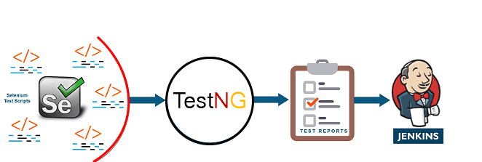
Introduction to DevOps
        Continuous Testing
The produced software is thoroughly tested for bugs on a regular basis.
TestNG, JUnit, Selenium, and other automation testing tools are used.
Docker Containers can be used to simulate the test environment at this phase.
The automation testing is handled by Selenium, and the reports are generated by TestNG.

Slide 15
Introduction to DevOps
        Continuous Monitoring
Monitoring is a component in the DevOps process that includes all operational elements.The software's usage is meticulously logged and analysed in order to spot trends and pinpoint trouble areas.

Slide 16
Introduction to DevOps
        Continuous Feedback
By analysing the results of the software's activities, the application development is constantly improved.
This is accomplished by establishing a key phase of constant feedback between operations and the development of the present software application's future iteration.

Slide 17
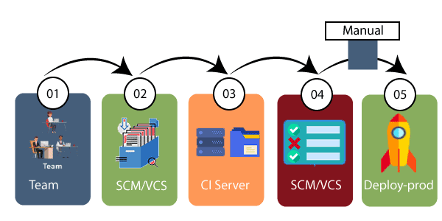
Introduction to DevOps
        Continuous Deployment

Slide 18
Introduction to DevOps
        Continuous Operations
All DevOps operations are built on a foundation of consistency and total automation of the release process, allowing the company to continually reduce its overall time to market.
We can improve the efficiency of any software product and raise the overall number of interested clients with DevOps.

Slide 19
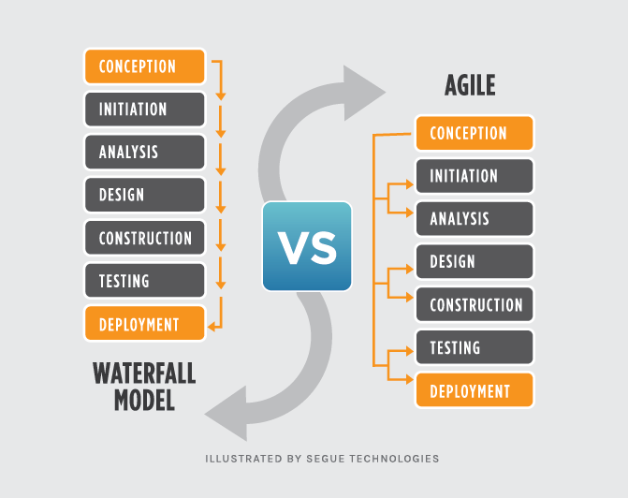
Introduction to DevOps
        Waterfall Model, & Agile Model

Slide 20
Introduction to DevOps
        Continuous Integration & Deployment (Jenkins)
After a code commit, Continuous Integration builds and tests the app right away. Commits are made often throughout the day in a large project with numerous developers.
Each commit results in the creation and testing of code. The build is then tested for deployment if the test passes. The code gets pushed to production if the deployment is successful.
This continuous process of commit, build, test, and deploy is known as continuous integration/deployment.

Slide 21
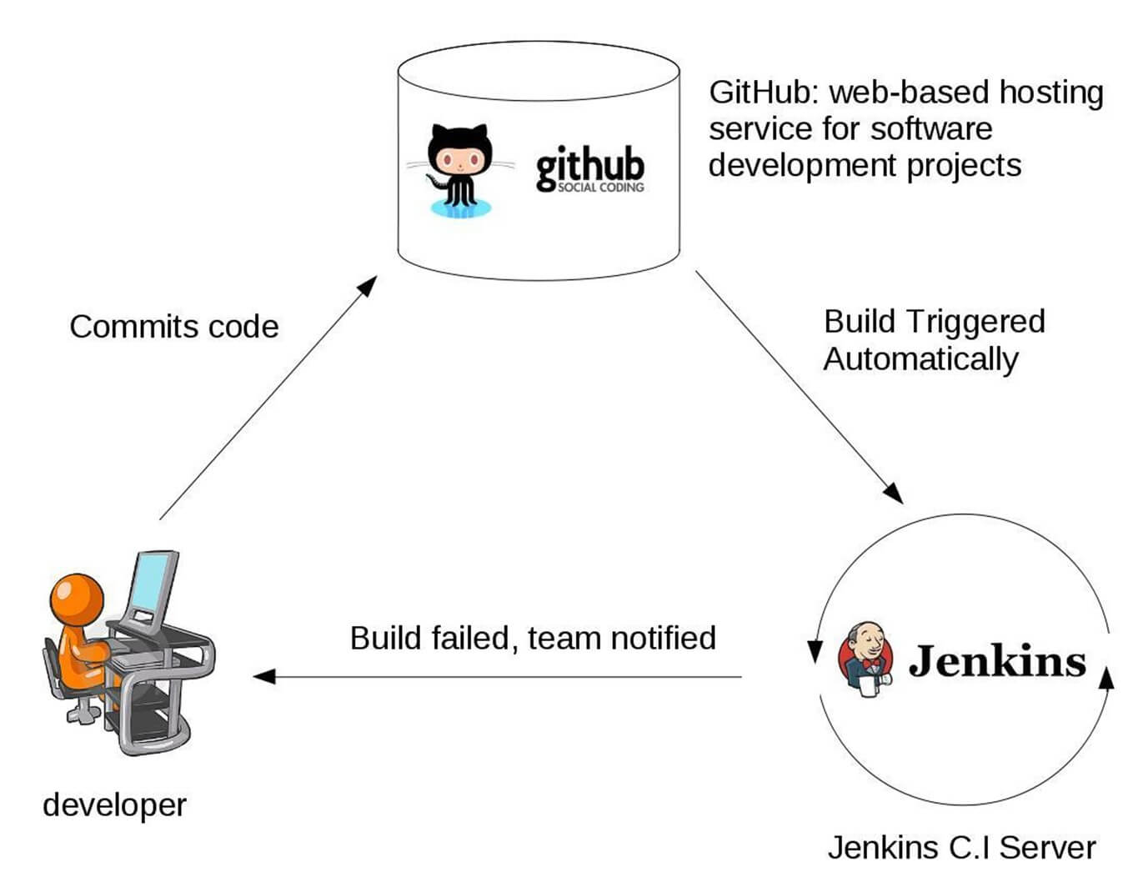
Introduction to DevOps
        Continuous Integration & Deployment (Jenkins)

Slide 22
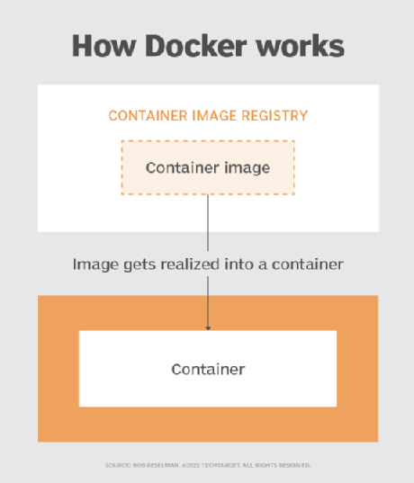
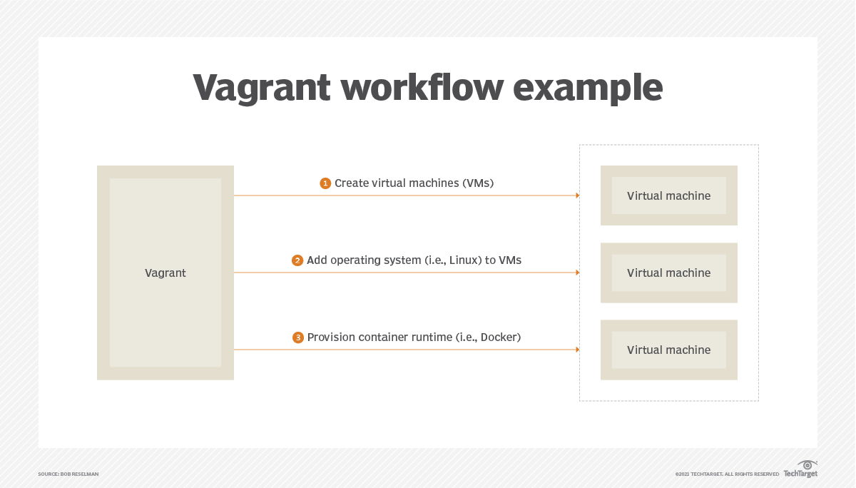
Introduction to DevOps
        Continuous Integration & Deployment (Jenkins)

Slide 23
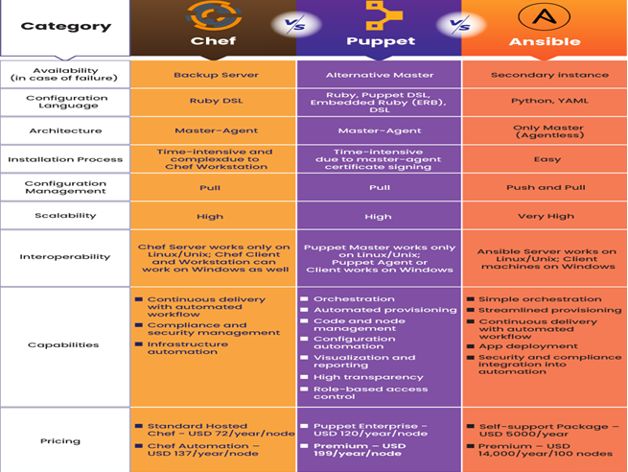
Introduction to DevOps
        Configuration Management Tools (Ansible, Puppet & Chef)

Slide 24
Introduction to DevOps
        Self Assessment Question
In a DevOps organization which one of the following elements does not directly contribute to your value stream?
      DevOps team
      Stakeholders of downstream work centers
      Errors, incidents and fixes
      Clients
      Answer: Errors, incidents and fixes

Slide 25
Introduction to DevOps
        Self Assessment Question
Which stage is the heart of the entire DevOps lifecycle.
      Continuous Testing
      Continuous Integration
      Continuous Monitoring
      Continuous Deployment
      Answer: Continuous Integration

Slide 26
Introduction to DevOps
        Document Link
Topic | URL | Notes
DevOps | https://www.javatpoint.com/devops | Include notes on DevOps
DevOps and Software Development Life Cycle (Waterfall Model, & Agile Model) | https://www.javatpoint.com/devops-lifecycle | Include notes on DevOps Life Cycle
Configuration Management Tools (Ansible, Puppet & Chef) | https://www.veritis.com/blog/chef-vs-puppet-vs-ansible-comparison-of-devops-management-tools | Include notes on DevOps Management Tools

Slide 27
Introduction to DevOps
        Video Link
Topic | URL | Notes
Introduction to DevOps | https://www.youtube.com/watch?v=7LcFZNuZaVY | This video Explain about DevOps Introduction

